Slide 1
Predicting Stock Prices Using Historical Data
Financial Data Analysis Using Python (Case Study 1)
Presentation By Yelena Mujibur Sheikh

Slide 2

Aim to Solve the problem:
1
Analyzing stock price data over five years (2020-2025)
2
Chosen Stock:
Understanding stock trends, risk, and variance for better investment decisions
Palo Alto Networks (PANW)
Check Point Software (CHKP)
CrowdStrike (CRWD)
Fortinet (FTNT)
Zscaler (ZS)
These are all cybersecurity companies
here is a reference:
https://www.alpharithms.com/python-financial-data-491110/
Load the repository

Slide 3
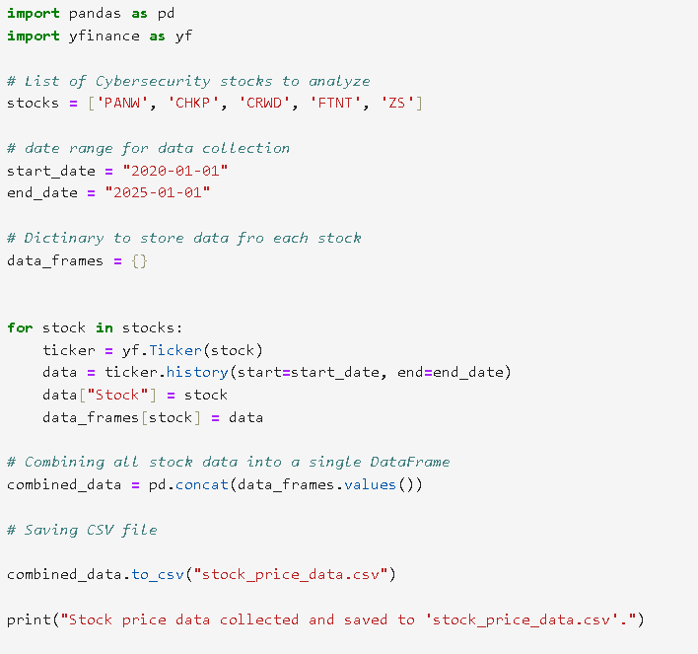
Data Extraction Using yFinance
3
Process: Extract historical stock data from Yahoo Finance
Load data into Pandas for analysis
Importing yFinance
Stock Listing data
Timeframe: 2020-2025 stock price data
Saving file: CSV file with stock data

Slide 4
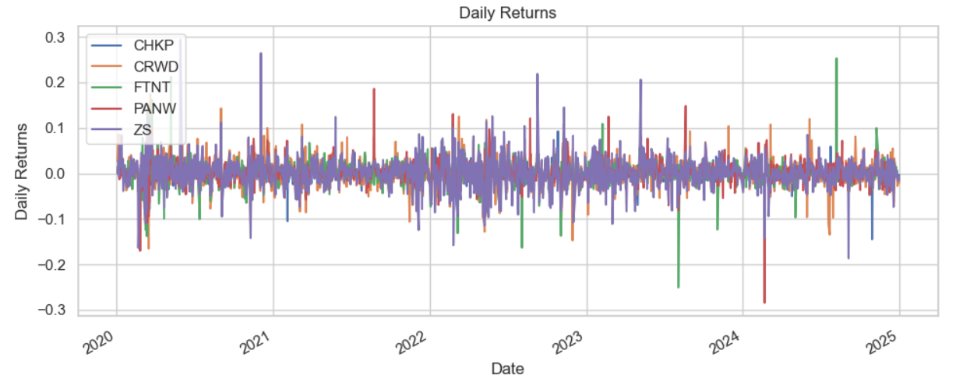
Variance Analysis & Tricks
4
Daily Returns: Measures short-term price changes.

Slide 5
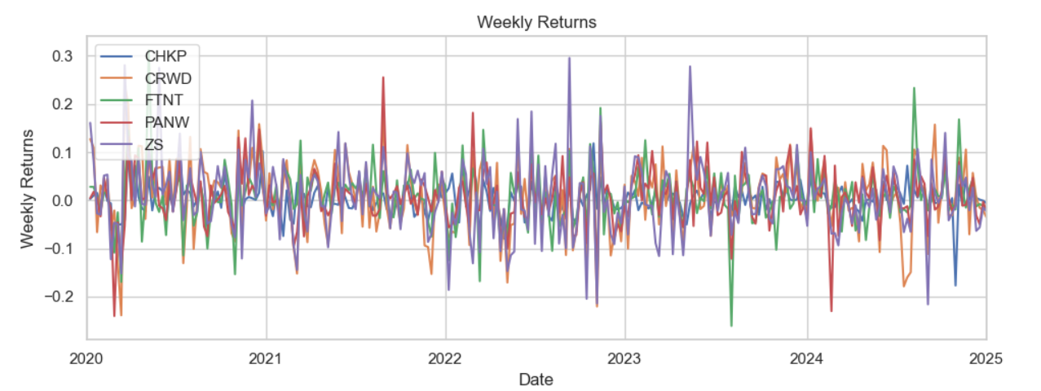
Variance Analysis & Tricks
4
Weekly Returns: Smoother than daily, capturing medium-term trends.

Slide 6
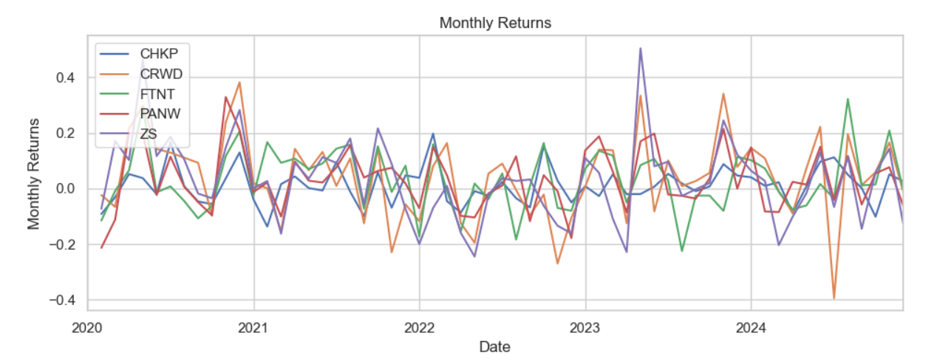
Variance Analysis & Tricks
4
Monthly Returns: Highlights long-term performance and investment potential

Slide 7
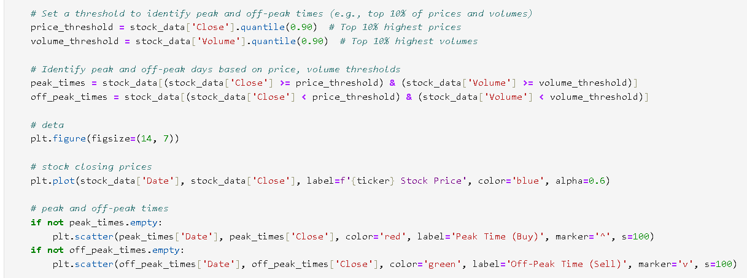
Identify Peak & Off-Peak Days
4
Peak Times: When the stock's closing price and trading volume exceed the 90th percentile.
Off-Peak Times: When both price and volume are below the threshold
Peak & Off-Peak Trading
Highlighting Peak
Trading Days (Buy Signals)
Stock Closing Prices (Blue Line)
Peak Trading Times (Buy Signals) – Marked in Red (▲)
Off-Peak Trading Times (Sell Signals) – Marked in Green (▼)

Slide 8
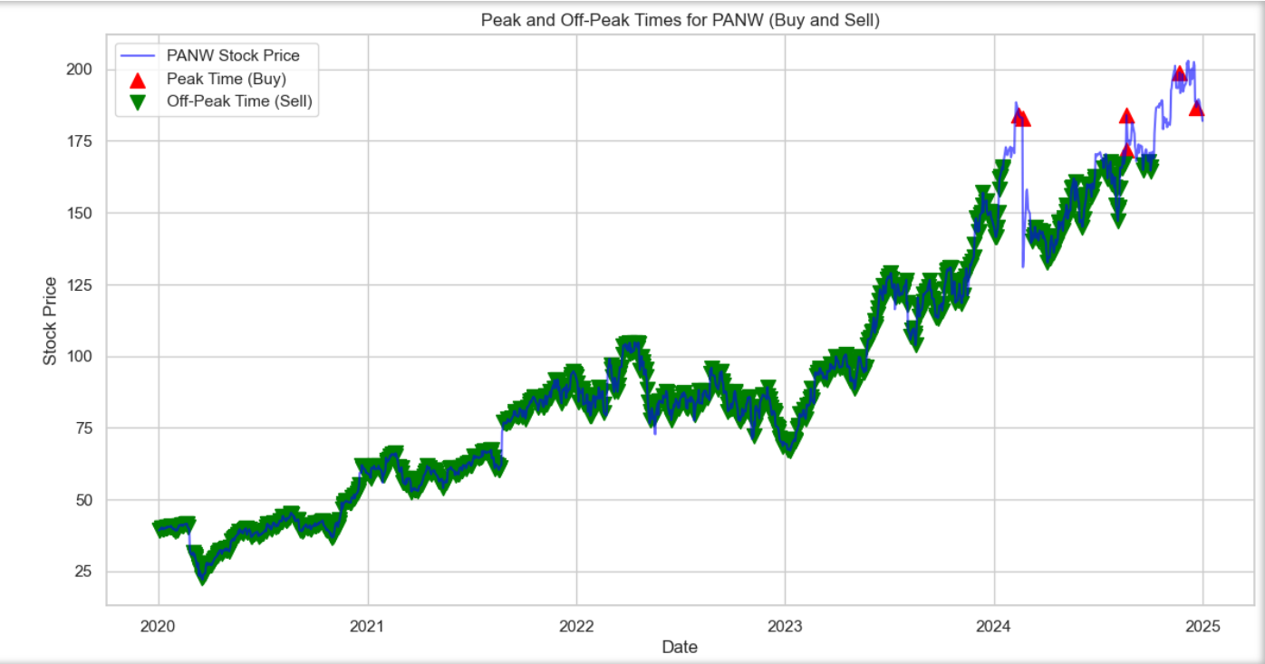
Uptrend: The stock price shows an overall increase from 2020 to 2025. 🔺 Peak Trading Times: More frequent as the stock price rises, indicating strong market confidence. 🔻 Off-Peak Trading Times: Appear consistently, possibly due to periodic market corrections.
Just like this, I have analyzed for rest of the 4 stocks:
Conclusion
Buying at off-peak times and selling at peak times could be a profitable strategy.
This analysis helps in timing trades and understanding stock behavior based on historical data.
Notes:
When conducting research, it is easy to go to one source: Wikipedia. However, you need to include a variety of sources in your research. Consider the following sources:
Who can I interview to get more information on the topic?
Is the topic current and will it be relevant to my audience?
What articles, blogs, and magazines may have something related to my topic?
Is there a YouTube video on the topic? If so, what is it about?
What images can I find related to the topic?

Slide 9
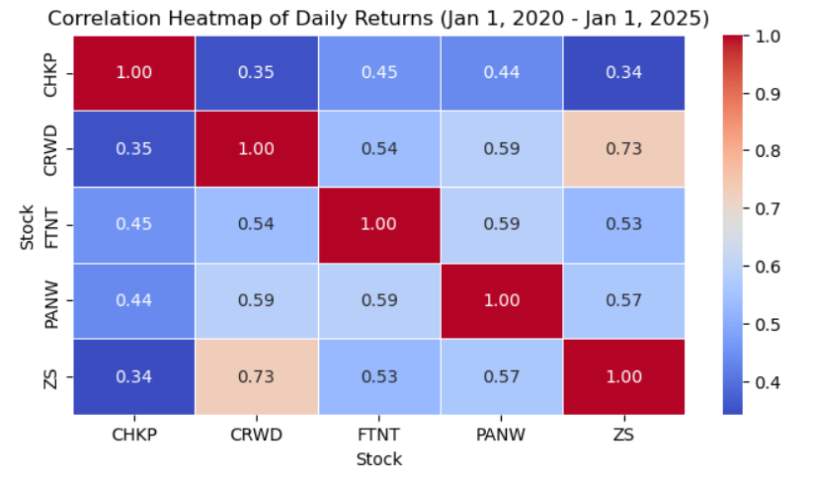
5
Key Insights from the Heatmap
CRWD and ZS (0.73): Strongest correlation, meaning their daily returns have moved closely together over time.
PANW and CRWD (0.59) and PANW and FTNT (0.59) also show moderate positive correlations.
CHKP shows the lowest correlations with other stocks (e.g., CHKP-ZS: 0.34), indicating its returns are more independent compared to others.
Use Case:
Investors can use this heatmap to diversify portfolios. A mix of lower-correlated stocks reduces risk.Traders may use highly correlated stocks for sector-based trading strategies.
Notes:
Once you find your sources, you will want to evaluate your sources using the following questions:
Author:
Who is the author?
Why should I believe what he or she has to say on the topic?
Is the author seen as an expert on the topic? How do you know?
Current:
How current is the information in the source?
When was the source published?
Is the information out-of-date?
Accuracy:
Is the content accurate?
Is the information presented objectively? Do they share the pros and cons?

Slide 10
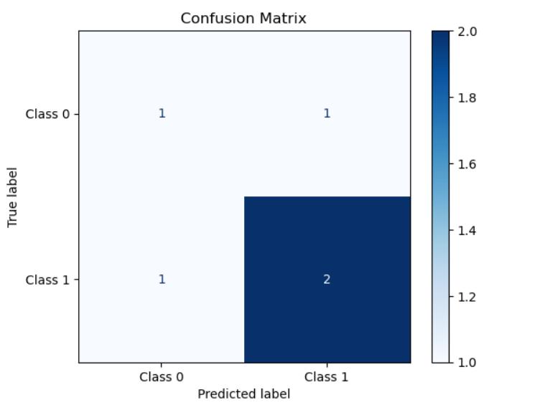

6
Key Insights: Confusion Matrix
 | Predicted Class 0 | Predicted Class 1
Actual Class 0 | 1 (True Negative) | 1 (False Positive)
Actual Class 1 | 1 (False Negative) | 2 (True Positive)
Interpretation of the Matrix
Notes:
Once you find your sources, you will want to evaluate your sources using the following questions:
Author:
Who is the author?
Why should I believe what he or she has to say on the topic?
Is the author seen as an expert on the topic? How do you know?
Current:
How current is the information in the source?
When was the source published?
Is the information out-of-date?
Accuracy:
Is the content accurate?
Is the information presented objectively? Do they share the pros and cons?

Slide 11
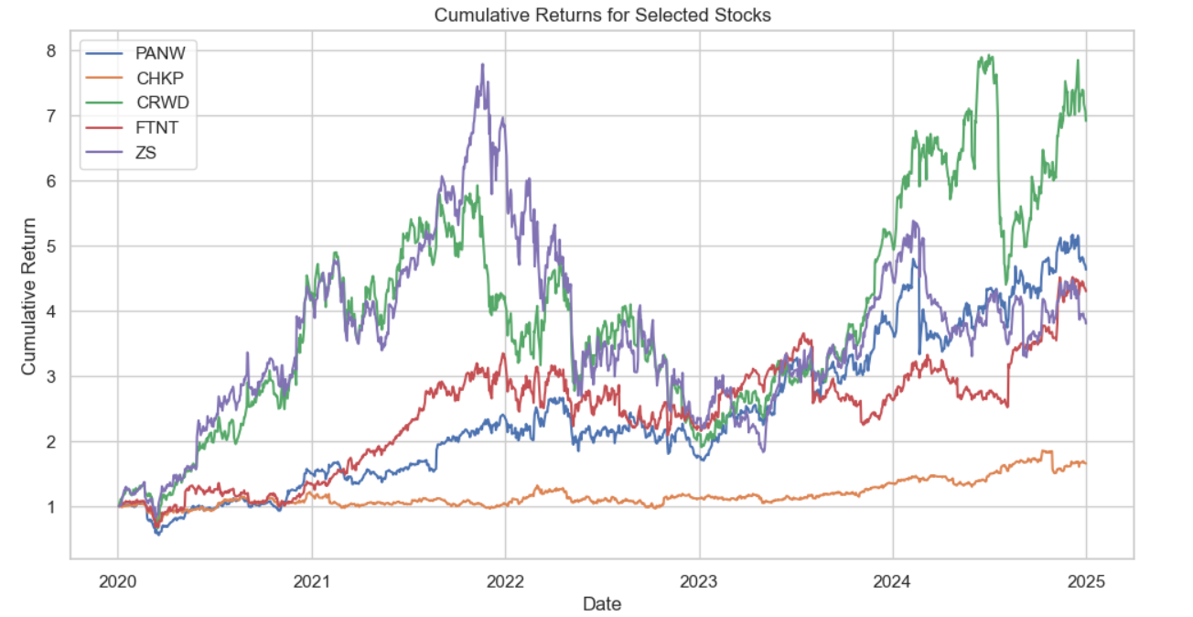
7
Key Insights: Returns
This cumulative returns chart (2020–2025) compares five cybersecurity stocks: CRWD and ZS show the highest growth but with high volatility, PANW and FTNT exhibit steady moderate gains, while CHKP has the lowest growth with stability. High-growth stocks suit risk-tolerant investors, while stable ones are better for conservative strategies
Notes:
Once you find your sources, you will want to evaluate your sources using the following questions:
Author:
Who is the author?
Why should I believe what he or she has to say on the topic?
Is the author seen as an expert on the topic? How do you know?
Current:
How current is the information in the source?
When was the source published?
Is the information out-of-date?
Accuracy:
Is the content accurate?
Is the information presented objectively? Do they share the pros and cons?

Slide 12
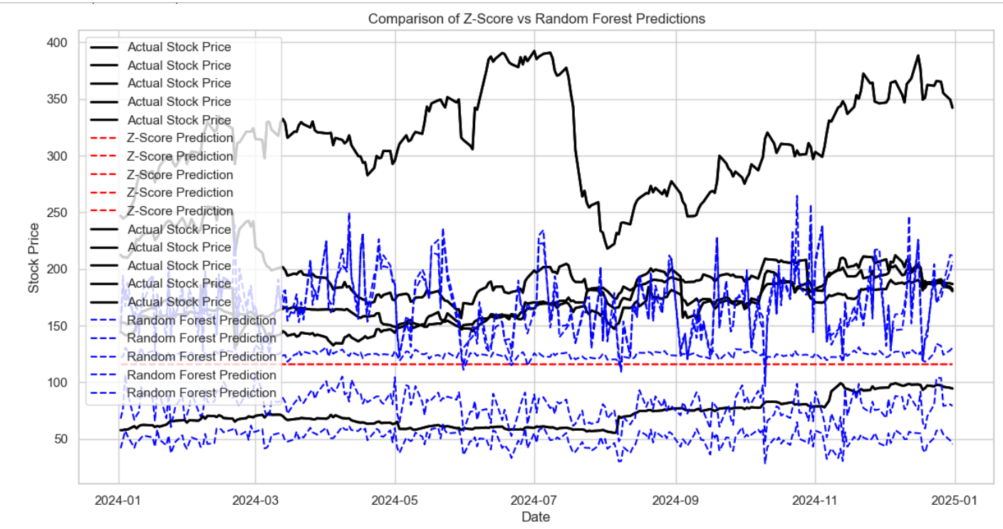
8
Compare: Z-score & Random Forest Model
Actual Stock Price Trends:
The black solid lines represent the real stock prices, showing an overall upward trend with some fluctuations.
Z-Score Predictions:
These appear as red dashed lines and seem relatively stable. They do not capture volatility well but may provide a baseline estimate.
Random Forest Predictions:
The blue dashed lines fluctuate significantly, indicating the model reacts more to short-term movements.It shows more variance but captures some aspects of stock price trends.
Comparison:
The Z-Score method provides smoother but less dynamic predictions.The Random Forest model is more volatile but aligns more closely with short-term fluctuations in actual prices.
Notes:
Once you find your sources, you will want to evaluate your sources using the following questions:
Author:
Who is the author?
Why should I believe what he or she has to say on the topic?
Is the author seen as an expert on the topic? How do you know?
Current:
How current is the information in the source?
When was the source published?
Is the information out-of-date?
Accuracy:
Is the content accurate?
Is the information presented objectively? Do they share the pros and cons?

Slide 13




Thank you
Yelena Mujibur Sheikh
Masters In Information Systems- Cybersecurity
www.linkedin.com/in/yelena-mujibur-sheikh-321215192
For a detailed analysis, please visit my GitHub page.

